Slide 1

INSTITUTE OF ENGINEERING AND TECHNOLOGY LUCKNOW
HACK-VOUCHER
Supervised By: Presented By:
Dr. Manik Chandra Nisar Ahmad(1805213033)
Mr. Ajit Shukla Pramod Arya(1805213040)
Shivam Shrivas(1805213053)

Slide 2
CONTENTS
Introduction
NEED
OBJECTIVE
Motivation
Methodology
TECHNOLOGY USED
SNAPSHOT OF PROJECT
ACTION PLAN CHART
FUTURE WORK & IMPROVEMENT
Conclusion
REFRENCES

Slide 3
INTRODUCTION
It is an online market place where user sell and buy the voucher that they get from different e-commerce website like google pay, amazon pay, BHIM , UPI etc. and are of no use for a particular user but useful for other. So basically, In this Project which we are building, voucher hosting platform where user can sell vouchers there and can purchase useful vouchers like discount coupons, cashback coupons etc in exchange of a point that is to be added in their wallet.

Slide 4
NEED
In Today’s World we all are using ecommerce website like flipkart , myntra ,Google Pay, Phonepay , AmazonPay where on using their site we get a voucher in form of rewards. Some voucher are of our use and some waste without redeeming because at that time they are not of our use. So by seeing this scenario we create a project where user can exchange their voucher that are of their uses.

Slide 5

OBJECTIVE
The aim of this project is to provide to the users, a full stack web application that will be useful for using a voucher that are provided by different ecommerce site as a gift like Flipkart, Google Pay. By this application users can easily buy and sell vouchers with the wallet money.

Slide 6
MOTIVATION
The voucher that we receive from e-commerce website are getting waste because most of are of not our use , so by seeing this scenario we motivate to use these voucher to exchange with other so that these voucher are used by other and we also used other vouchers that are of our use by exchanging with coins.
it is an online market place with the largest user posted inventory of un- used gift vouchers/ cards. It connects the Buyers and Sellers, allows them to negotiate and arrive at a workable price which works for both the buyer and seller. Hence it will be the cheapest for the buyer and mostly a definite sale for the Seller.

Slide 7
METHDOLOGY
Authentication and authorized user using passport.js.
Add vouchers section where we can add the vouchers in that application.
Displaying all the vouchers in different view at home page.
Buy vouchers link on all the vouchers from where we can buy any card.
Profile section for all the users where tracking of remaining of wallet money quantity of host vouchers and buy vouchers and likes.
Dedicated section for filtering of vouchers with different check boxes for both on the basis of price and company

Slide 8
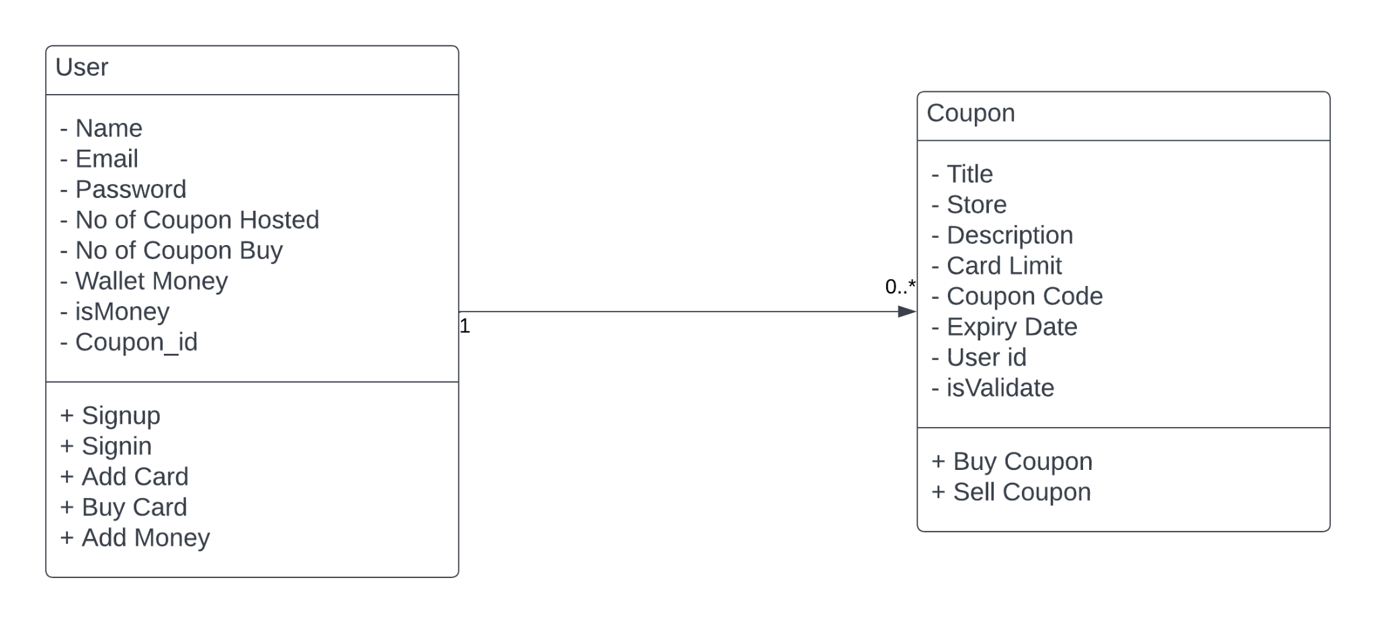
Class Diagram

Slide 9
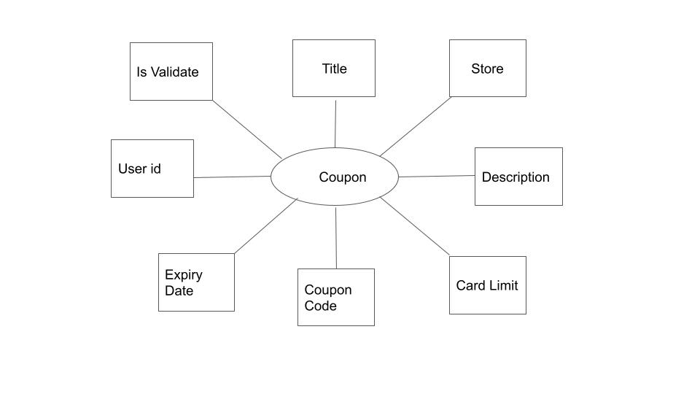
Coupon schema

Slide 10
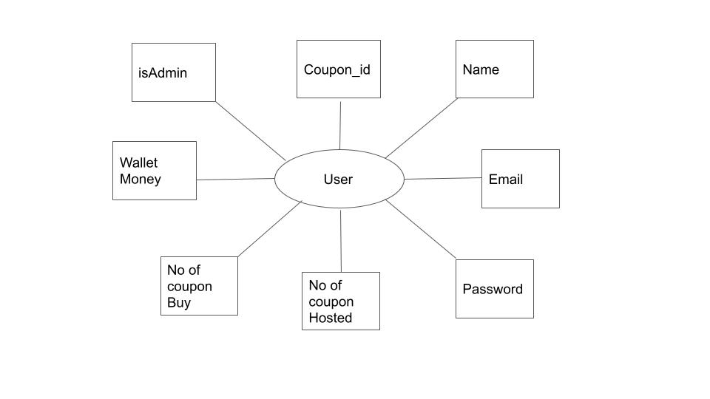
User Schema

Slide 11
TECHNOLOGY USED
GUI Frontend- HTML/CSS, Bootstrap, JavaScript
Backend- NodeJS, ExpressJS
IDE- Visual Studio Code
Database- MongoDB
Version Control System- Git ,Github
Deployment- Heroku
Other tools- Postman, Nodemailer, MongoDB Compass.

Slide 12
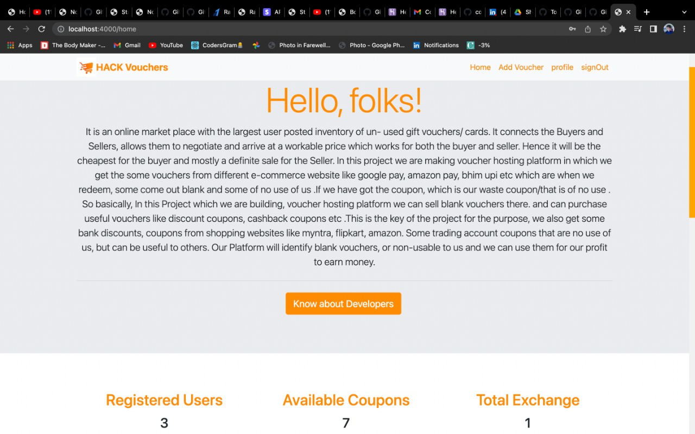
SOME SNAPSHOT OF PROJECT

Slide 13
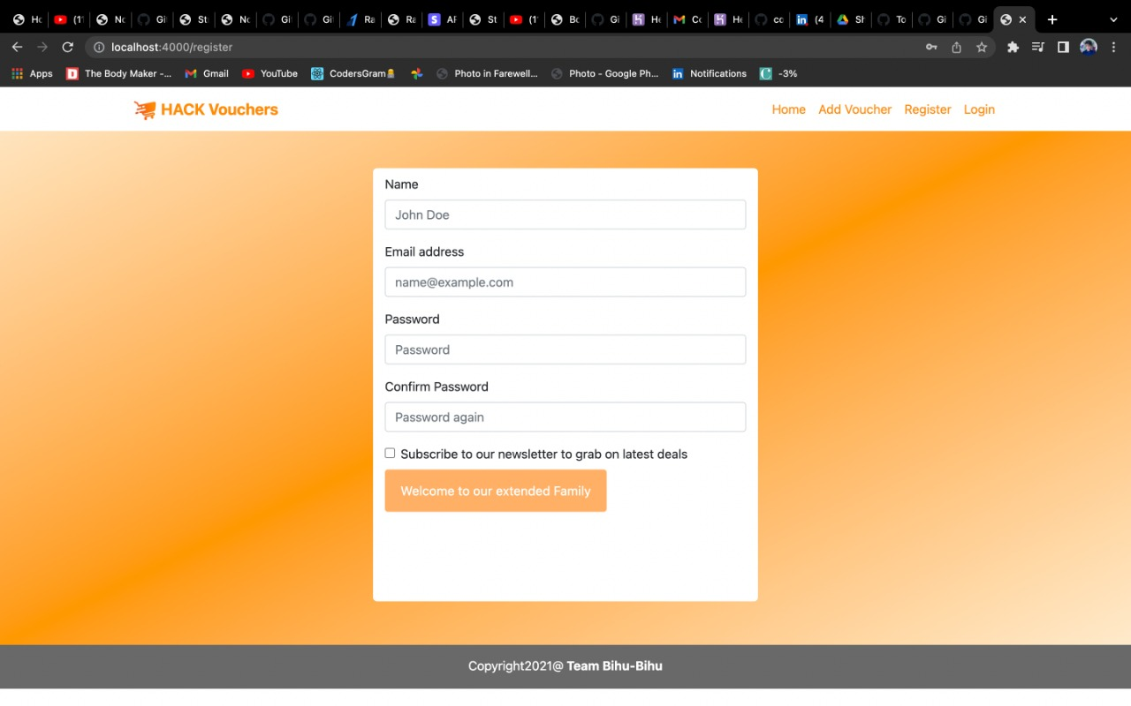
SIGN UP PAGE

Slide 14
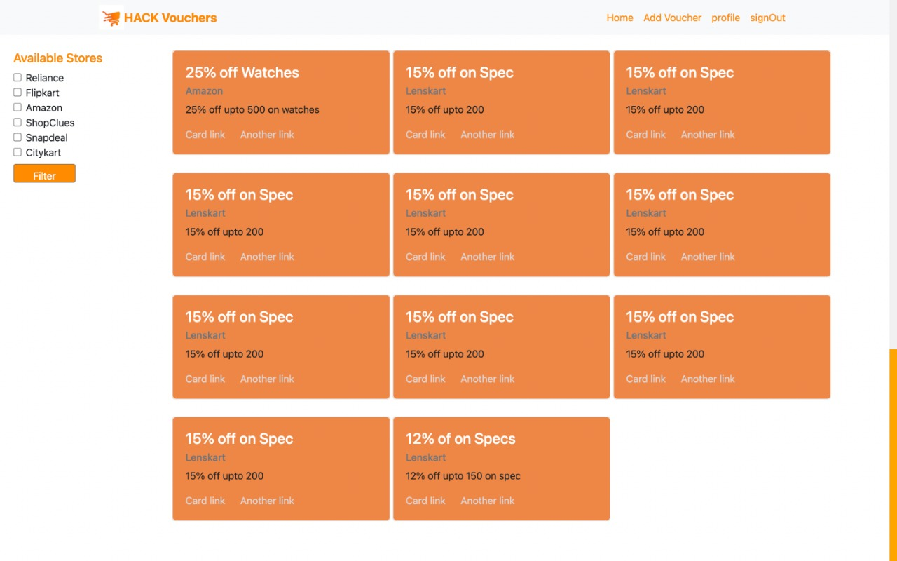
HOME PAGE SHOWING AVAILBLE VOUCHERS

Slide 15
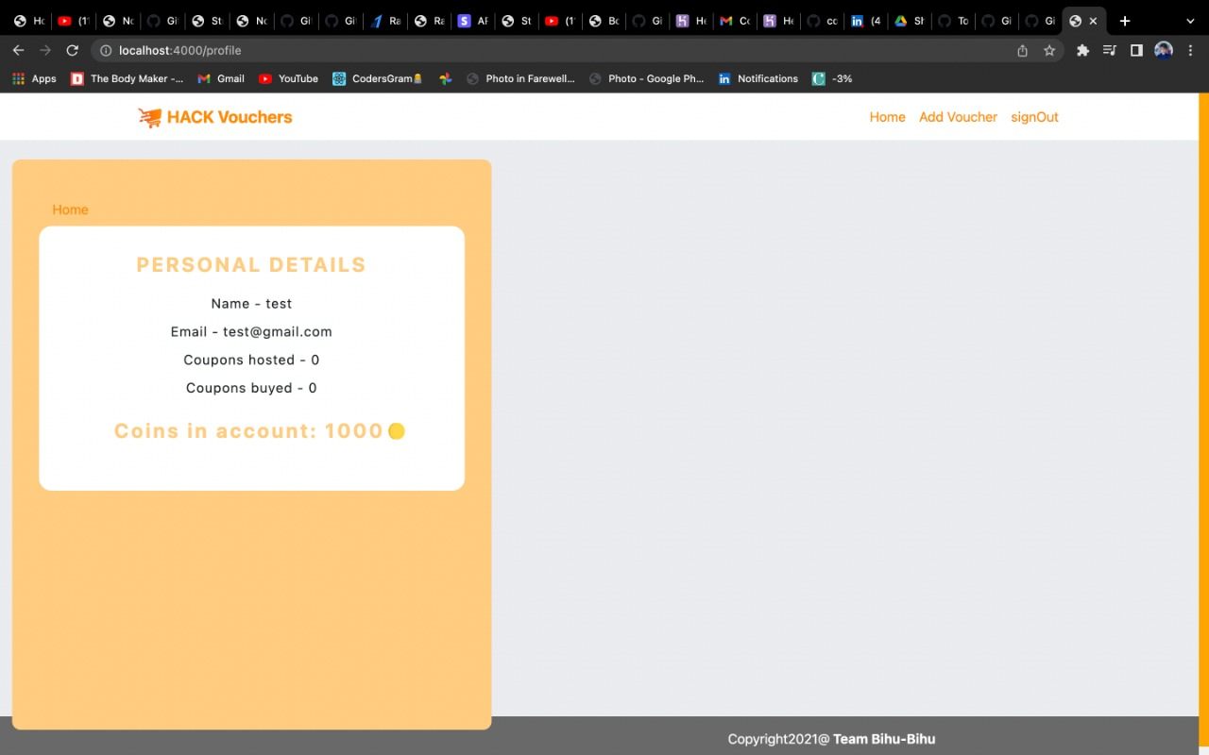
USER PROFILE

Slide 16
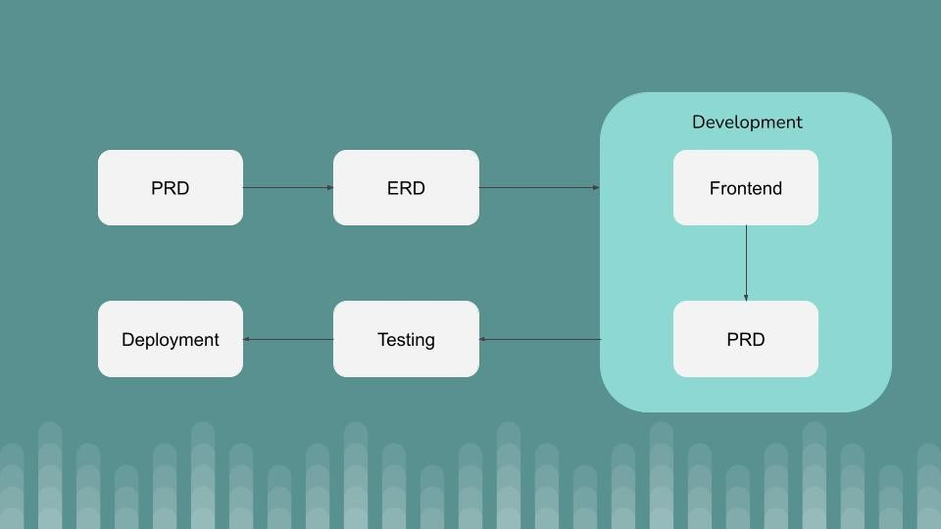
Different stages of the Software Cycle Action plan.

Slide 17
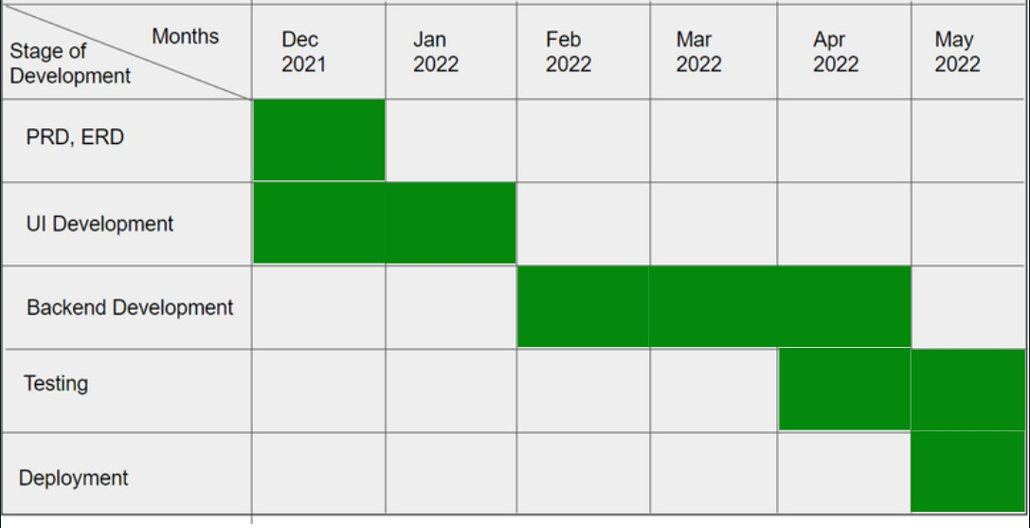
PLAN OF ACTION TIME CHART

Slide 18
FUTURE WORK & IMPROVEMENT
Hack -Voucher is very useful in many aspects for the users because in pandemic time all the e-commerce companies gives gift cards and vouchers for purchasing their products and also we get cashbacks by payments apps like google pay, phone pay , paytm etc. Now they found the base of customers so now they give gifts cards and vouchers that are oftenly unusable for us .So here we provide a web application platform where users can sell their unused gift card and vouchers and purchase usable vouchers and gift cards.We can also include a section for negotiation where users can negotiate on purchasing and selling of vouchers and gift cards.This feature is available to only logged in users

Slide 19
FUTURE WORK & IMPROVEMENT
We can also develop android apps and launch on play store .android app make more interactive UI and easy to use for users
We can also implement filter such a way that user view voucher of their interest and also get a notification on their profile and email when someone added a voucher of their interest.
We will include automate verification of vouchers.

Slide 20
CONCLUSION
The end result of the mentioned methodology and planned action will be a highly interactive UI with working functionalities of a Hack -voucher, which will keep user data secure and will be able to handle customized coupon/gift card search for an user. This web application aims to eliminate the wastage of unused vouchers/gift cards. We also get some bank discounts, coupons from shopping websites like myntra, flipkart, amazon. Some trading account coupons that are of no use to us, but can be useful to others. Our Platform provide users coins in exchange of money that is our profit to earn money.

Slide 21
REFRENCES &RESEARCH ARTICLE
https://www.geeksforgeeks.org/
https://www.researchgate.net/publication/283699248_Gift_cards_a_review_and_research_agenda
https://www.persistencemarketresearch.com/market-research/gift-card-market.asp
https://stackoverflow.com/
https://www.tutorialspoint.com/index.htm
https://w3schools.com/

Slide 22
THANK YOU

